Slide 1
Identifying cavities on bitewing x-rays

Slide 2
Background
Dental cavities are one of the most common diseases.
Dental cavities appear as radiolucencies or dark shadows on certain areas of dental bitewing x-rays.
The goal of this project is to train models to identify dental cavities on x-rays using bitewing images collected from Google image search.
The model could help dentists save time by pre-screening the x-rays, and it could help patients better understand their own health.

Slide 3
Data Collection
Bitewing images are collected from Google image search with keyword 'dental bitewing x-ray'.
Unique bitewing images are saved and labeled with the name of the original website.
The images are randomly selected into training set and test set.
Training images that contain teeth with one or more cavities are saved in the folder named 'cavity'.

Slide 4
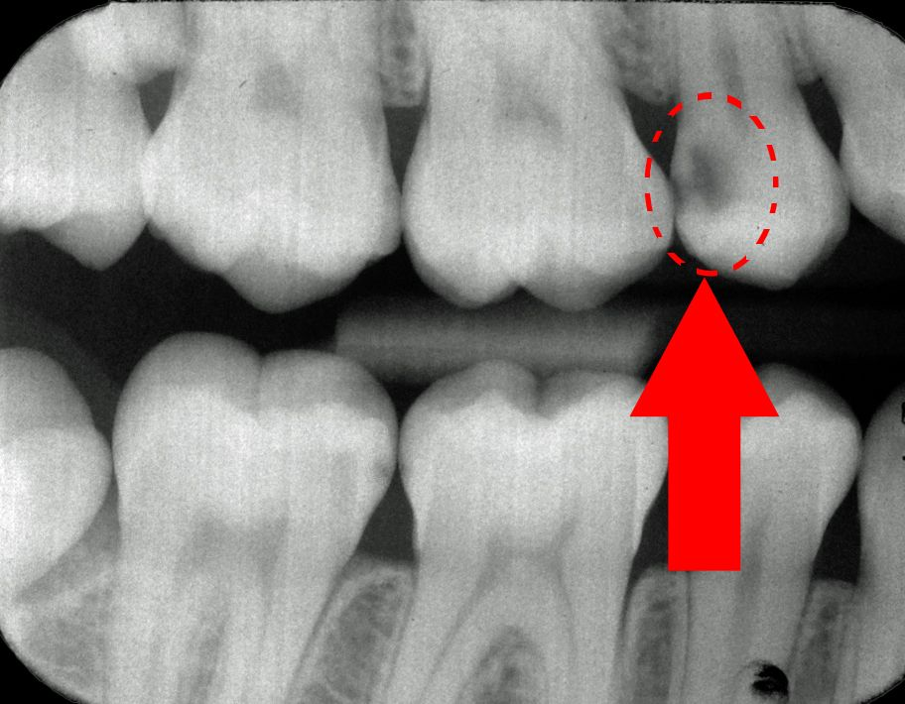
Cavity as indicated in the circle

Slide 5
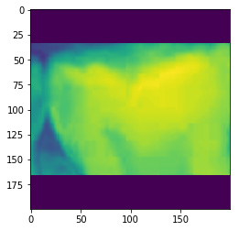
Open CV was used to label cavity and non-cavity on x-rays.
Below is a cropped image with cavity on the left side of the tooth. Cropped images are resized and bordered to have uniform shape.

Slide 6
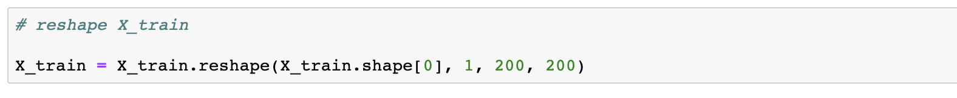
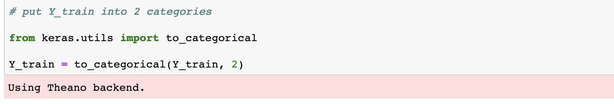
Data Processing
Reshape X-train
put Y-train into categories

Slide 7
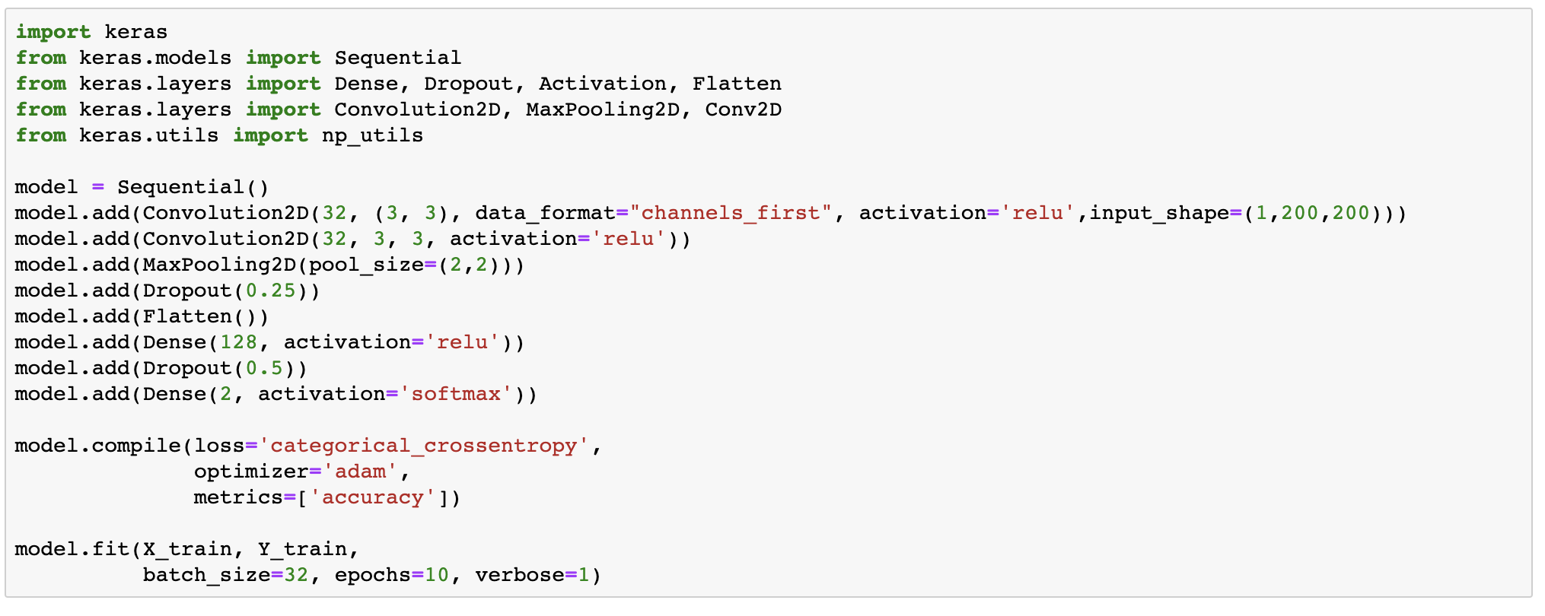
Modeling
Modeling directly on this small dataset was performed first using Sequential model.

Slide 8
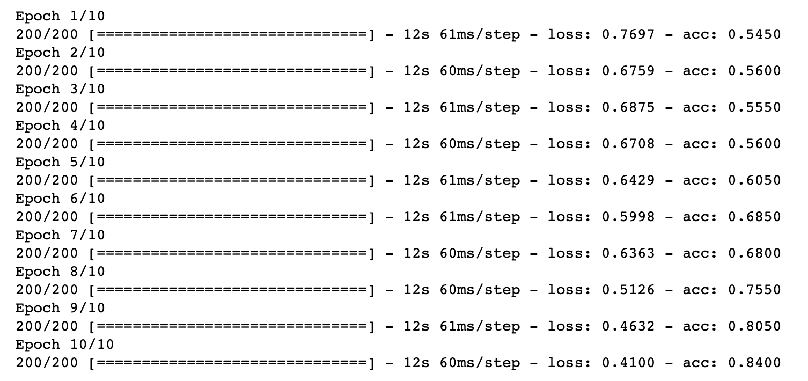
The following is the result:

Slide 9
Towards the last Epoch, the accuracy has increased to 0.84, which is very accurate considering the small size of the data set.
However, checking the test set gives 0.5 accuracy.
In the test set, half of the images are cavity and the other half are non-cavities.
The testing result suggests that the model is labeling all images as either cavity or non-cavity.
The model is clearly overfitting for the training set.

Slide 10
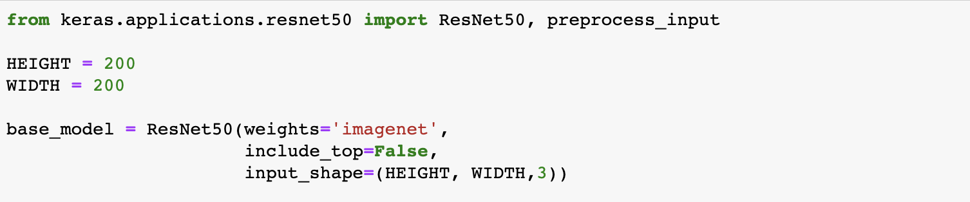
Transfer learning using ResNet50
Due to the small image size, we next tried transfer learning using a commonly used pre-trained model ResNet50.

Slide 11
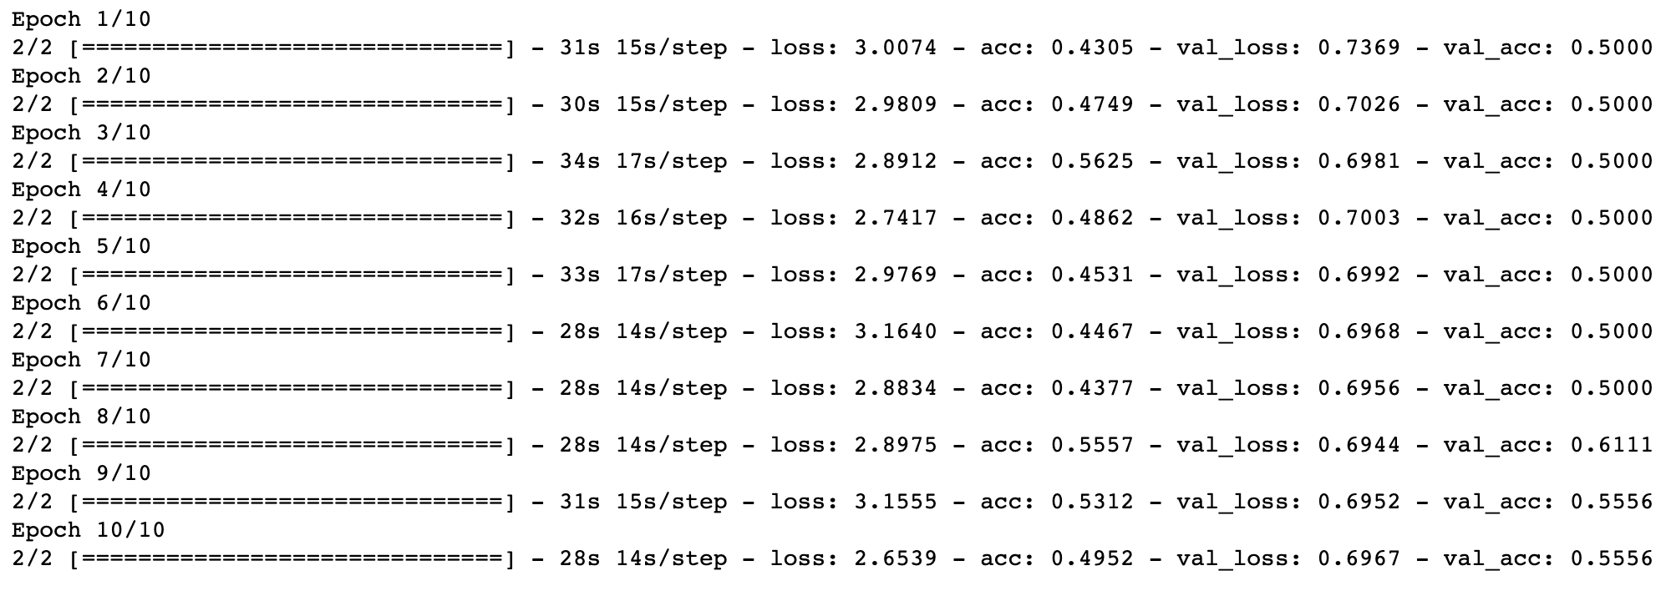
The following is the result:

Slide 12
The result also suggests overfitting of the training data and labeling all testing data into one category.
This is likely due to the dataset was too small, the cavities were not very apparent for the models, or the pre-trained model doesn’t work well with x-ray images.

Slide 13
Cats vs dogs on ResNet50
In order to check that the model doesn’t work well with x-ray data but could work with other types of images, we use the same model on cats vs dogs dataset of the same amount. From Kaggle we obtained 200 images of cats or dogs. Here we used the same ResNet50 pre-trained model to identify cats vs dogs.

Slide 14
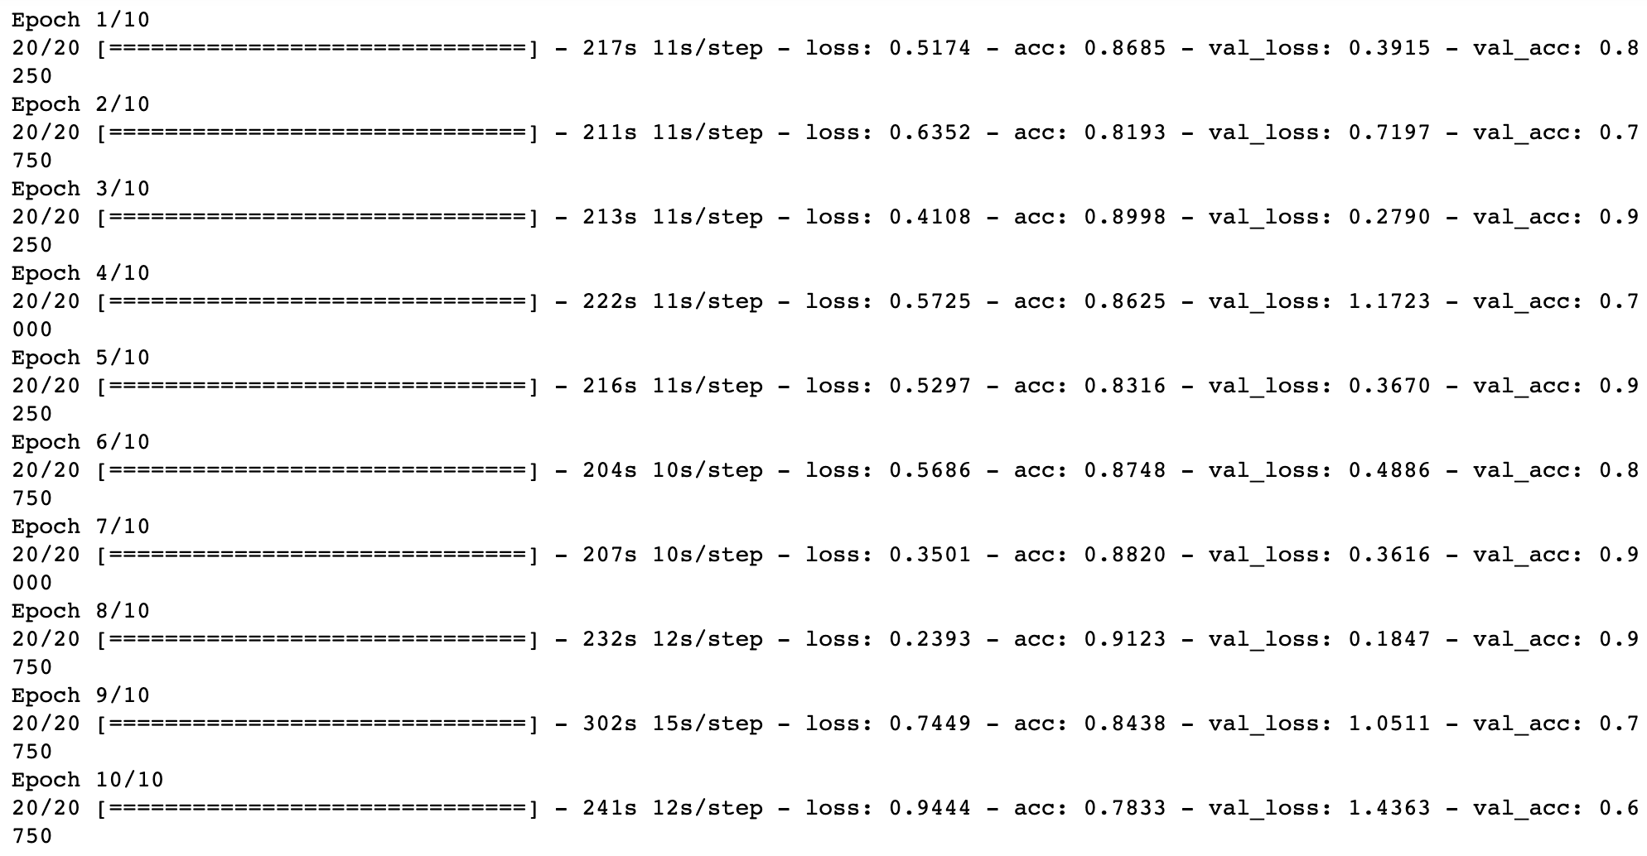

Slide 15
The results show improvement compared to the x-ray data.
It suggests that the cavity data could be too difficult to identify, or ResNet50 is not working so well with x-ray data.

Slide 16
Future direction
In the future I will try transfer learning using a model that has been pre-trained on x-ray data. The models will learn features of x-ray data that could be helpful for the cavity dataset. Features from the pre-trained model running on cavity dataset will be extracted. These deep features can then be used to train a classifier to help identify cavities.

Slide 17
Thank you!

